Slide 1
DEEPGUARD AI
09 / 09
DeepGuard
AI
“Detect. Verify. Decide.”
[Ctrl Alt Elite]
[PSN012] AI-Driven Deepfake & Synthetic Media Detector: Develop a lightweight model that flags
manipulated images, video, or audio in real time, helping platforms and users identify synthetic or
altered media before it spreads.]
N SIVARAMAN
TM BHATRATHWAJ GUHAN
M ABISHRI
T RAKSHITHA

Slide 2



DEEPGUARD AI
01 / 09
THE PROBLEM
The Problem
AI-generated images are getting harder to tell apart from real ones.
Can’t verify
Slow and hard
Not in the workflow
Users cannot easily tell whether an image is AI-generated or real.
Manual verification is slow and difficult for everyday users.
Existing detection methods aren’t always available right in the user’s browsing workflow.

Slide 3
DEEPGUARD AI
02 / 09
TWO FACES
What it costs today, what we build
WHAT IT COSTS USERS TODAY
WHAT WE ARE BUILDING
Manually investigate suspicious images
Switch between websites/tools to verify
Spend significant time checking authenticity
Risk trusting misleading or synthetic content
DeepGuard AI
Detects AI-generated/manipulated images in the browser
Upload an image or analyze while browsing
Returns AI probability + clear REAL / AI-GENERATED result
Fast, accessible, built for everyday users

Slide 4







DEEPGUARD AI
04 / 09
TECHNICAL APPROACH
How it works
Image
Preprocessing
Detectra ONNX Model
AI Probability
Verdict
MODEL
DATA
TOOLS & FRAMEWORKS
Detectra v3
Vision Transformer-based, pretrained
ONNX format
384 × 384 image input
Known REAL images
AI-generated images
Independent evaluation images
External unseen dataset evaluation
Python · PyTorch / torchvision
ONNX Runtime · ONNX Runtime Web
JavaScript · Chrome Extension
HTML/CSS · Google Colab · Hugging Face

Slide 5





DEEPGUARD AI
03 / 09
USER EXPERIENCE
Three steps, one verdict
WHAT THE USER DOES
1
2
3
Upload or click
AI analyzes
Get the result
Upload an image, or click one while browsing
DeepGuard AI analyzes the image
The user receives the verdict
WHAT THE USER GETS BACK
REAL or AI-GENERATED / MANIPULATED verdict
AI probability percentage
Probability visualization
Reminder: an AI-assisted prediction, not absolute proof

Slide 6

DEEPGUARD AI
06 / 09
KEY MILESTONES
What we will do by 1 Oct
Working pretrained ONNX detector
Browser-based inference
Chrome Extension integration
Image upload detection
Click-to-analyze image workflow
REAL / AI-GENERATED result
AI probability display
Working end-to-end demonstration

Slide 7
DEEPGUARD AI
08 / 09
BASELINE & TARGET
Time to result
TODAY
TARGET — WITH DEEPGUARD AI
30 min
3 min
Manual verification and research
Target end-to-end verification workflow
10× faster verification workflow (target)
Workflow target — not the AI model’s inference time.

Slide 8

DEEPGUARD AI
07 / 09
EVALUATION
How we will prove it works
INDEPENDENT EVALUATION ON A SMALL 62-IMAGE TEST SET
88.71%
29 AI-generated + 33 REAL images
REPORTED BY MODEL AUTHOR — NOT OUR INDEPENDENT RESULT
accuracy · 55 / 62 correct
[Add the benchmark figure from the Detectra v3 model card here]
95.83%
79.31%
86.79%
Precision
Recall
F1-score

Slide 9



DEEPGUARD AI
05 / 09
HUMAN APPROVAL
AI assists. Humans decide.
DeepGuard AI provides
The user decides
AI probability
Detection verdict
Visual confidence indicator
The final decision always remains with the user.
“AI detection is probabilistic and should not be treated as definitive proof of authenticity.”

Slide 10
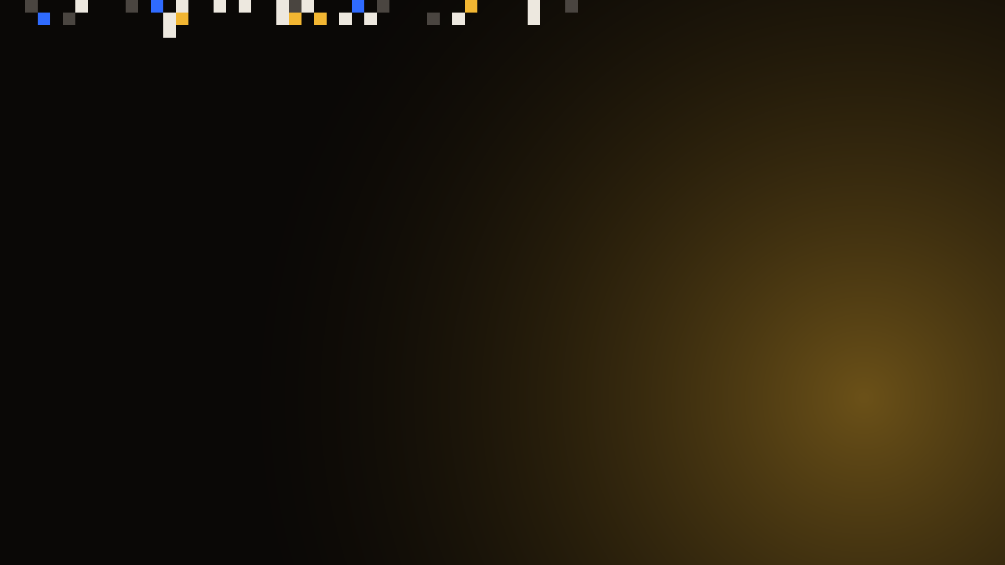
✱ BFWAI/HACK 26
Thank you
[Ctrl Alt Elite] · [PSN012]
Thank you.
[www.linkedin.com/in/abishri-m-21ab3b375]
buildfastwithai.com/hackathon ↗
10 / 10

